Slide 1

SYNTHETIC DATA

Slide 2



OUR TEAM MEMBERS
Anwesha Malana
Yashas Gune
Anwesha Malana
Pritish Kumar Bhakat
OUR MENTORS
Vaibhav Arya
Aaditya Verma
2

Slide 3

SYNTHETIC DATA
Artificially generated data
Mimics the statistical properties of real-world data.
Does not contain any sensitive information.
3

Slide 4

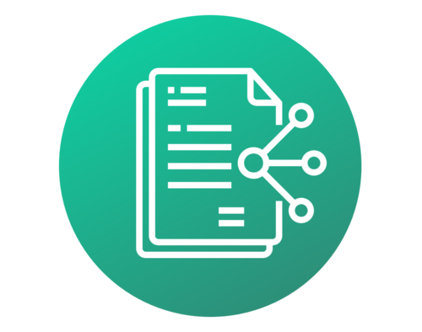

Applications
DATA SHARING WITH THIRD PARTY
ENABLING INNOVATION AND ANALYTICS
AI/ML MODEL TRAINING
4

Slide 5


CHALLENGES WE FACE WHILE OBTAINING SYNTHETIC DATA
(With Hazy Tool)
Seeking Approval for sensitive data
Data transfer
to an external platform
Waiting for a week or more
Potential data security breach
To overcome these setbacks, we can opt for better alternatives for generating synthetic data
5

Slide 6
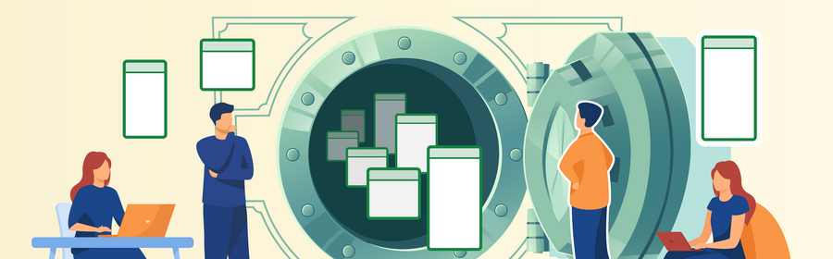
SYNTHETIC DATA VAULT (SDV)
One-stop shop for creating synthetic data
6

Slide 7

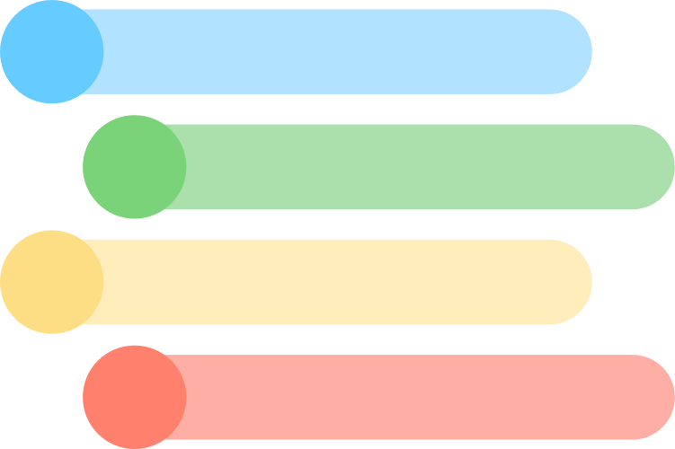
F
E
A
T
U
R
E
S
Multiple machine learning models
Generate synthetic data for single table,
multiple connected table
or sequential data
What we provide:
Pre-Processing
Data Adjustments
Smooth UI
Optimization
Evaluate and visualize data
Anonymization
7

Slide 8



OUR JOURNEY
Directly connecting to the snowflake
MULTIPLE TABLE
>5 table data
>1 degree relationship
Single Table
> 1 table
>Excel format
Exploring Synthetic Data Vault
8

Slide 9
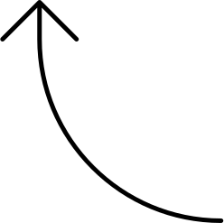

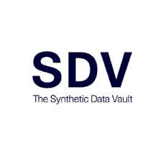
SINGLE TABLE DATA
A Single
Excel file
Data pre-processing
Metadata
Gaussian
Copula
Synthesizer
An Excel file of
Synthesized data
9

Slide 10

MULTIPLE TABLE DATA
5 Table along with its metadata file
(json format)
Data pre-processing
Metadata
DEMO
HMA
Synthesizer
Synthesized data zip file
10

Slide 11
CHALLENGES WE FACED :
1. Mapping of SQL Data types with SDV types :
Real Data:
EMPLOYEE_ID
ex.A123456
SQL Datatype:
varchar
Synthesized Data:
EMPLOYEE_ID
147483
SDV Type: ID
DRAWBACK: Synthetic score is reduced
SOLUTION:We can suggest regex format to the user and take suggestion from user.
11

Slide 12
2. SDV provides synthesizer for 5 tables and 1 degree Relationship
It is optimized for datasets with 5 tables with around 10 columns each and 1 level of depth(eg. a parent and its child table
DRAWBACK: More time taken for complex tables.
SOLUTION:SDV Enterprise Synthesizer for multiple complex tables .
12

Slide 13
THANK
YOU
Special thanks to our mentors Vaibhav Arya, Aaditya Verma, Abhishek Sharma, Sambhav Gaur, Meenu and Innovation
team for their support and guidance
13

